Slide 1
SECTION 1
Chapter 3, 4 and 5

Slide 2
Introduction
Yu (Zoey) Zhu
Email: yuzhu201@ucsc.edu
Sections: Friday, 5 - 6 PM
No Office Hour and Attend Lectures
Section Materials: https://github.com/YuZoeyZhu/STAT05-TANotes

Slide 3
Histogram
Variables
What is Histogram?
How to Draw a Histogram?
Interpretations
CHAPTER 3

Slide 4
Variables
Qualitative: discriptive data, such as marital status and employment status
Variables
Discrete: counted, such as family size and the number of student in the class
Quantitative:
numerical
Continous: can take any value within a range, such as temperature and a dog’s weight

Slide 5
What is Histogram?
A graph to examine the distribution of a variable (quantitative) and summarize large amounts of data.
Frequency Histogram
Density Scale Histogram

Slide 6
How to Draw a Histogram?
Example: the number of cigarettes taken per day (100 samples)
[1] 1 1 2 3 4 1 3 2 4 3 4 5 6 3 2 1 1 1 1 1 3 5 4 2 2
[26] 2 3 4 5 11 1 2 3 4 3 3 3 3 3 3 4 6 8 5 5 6 1 9 3 3
[51] 2 2 1 1 1 1 1 3 3 2 2 2 2 6 4 1 4 6 2 2 3 4 1 1 1
[76] 6 5 6 4 2 2 2 3 4 1 1 2 2 3 4 1 1 8 5 5 9 2 4 1 1
Step 1: List all the data in an increasing order
[1] 1 1 1 1 1 1 1 1 1 1 1 1 1 1 1 1 1 1 1 1 1 1 1 1 1
[26] 2 2 2 2 2 2 2 2 2 2 2 2 2 2 2 2 2 2 2 2 2 3 3 3 3
[51] 3 3 3 3 3 3 3 3 3 3 3 3 3 3 3 3 4 4 4 4 4 4 4 4 4
[76] 4 4 4 4 4 5 5 5 5 5 5 5 5 6 6 6 6 6 6 6 8 8 9 9 11
Step 2: Decide on class interval size (“class interval” is the technical word for each of the “bins” that define the bars). Every bin should be adjacent and often (not required to be) of equal size.
[0, 2] (2, 4] (4, 6] (6, 8] (8, 10] (10, 12]
46 34 15 2 2 1

Slide 7
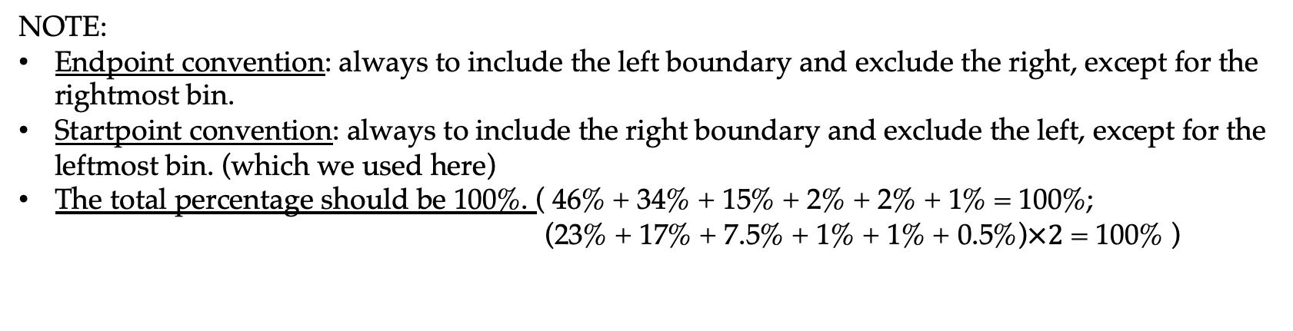
Step 3: Draw the distribution table
Number of Cigarettes Per Day | Counts | Percent | Percent Per Unit
0 - 2 | 46 | 46 | 23
2 - 4 | 34 | 34 | 17
4 - 6 | 15 | 15 | 7.5
6 - 8 | 2 | 2 | 1
8 - 10 | 2 | 2 | 1
10 - 12 | 1 | 1 | 0.5
Counts per bin / Total number of sample
(Eg: 46 / 100 = 46%)
Percent per bin / Size of the bin
(Eg: 46% / 2 = 23%)
NOTE:
Endpoint convention: always to include the left boundary and exclude the right, except for the rightmost bin.
Startpoint convention: always to include the right boundary and exclude the left, except for the leftmost bin. (which we used here)
The total percentage should be 100%. ( 46% + 34% + 15% + 2% + 2% + 1% = 100%;
(23% + 17% + 7.5% + 1% + 1% + 0.5%)$×2$ = 100% )

Slide 8
Step 4: Draw the histogtam
Horizontal axis:
the units of what is measured
Vertical axis:
the percentage per unit
Height of each bar:
the percentage per horizontal unit；
shows crowding
The area of each bar:
the percentage of population that fall in that
interval

Slide 9
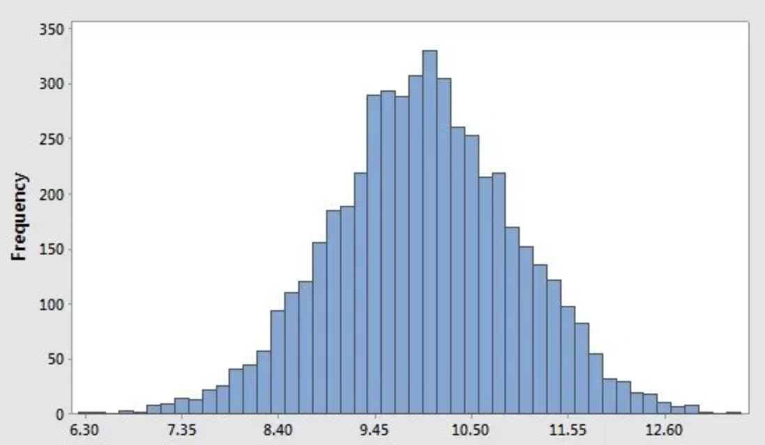
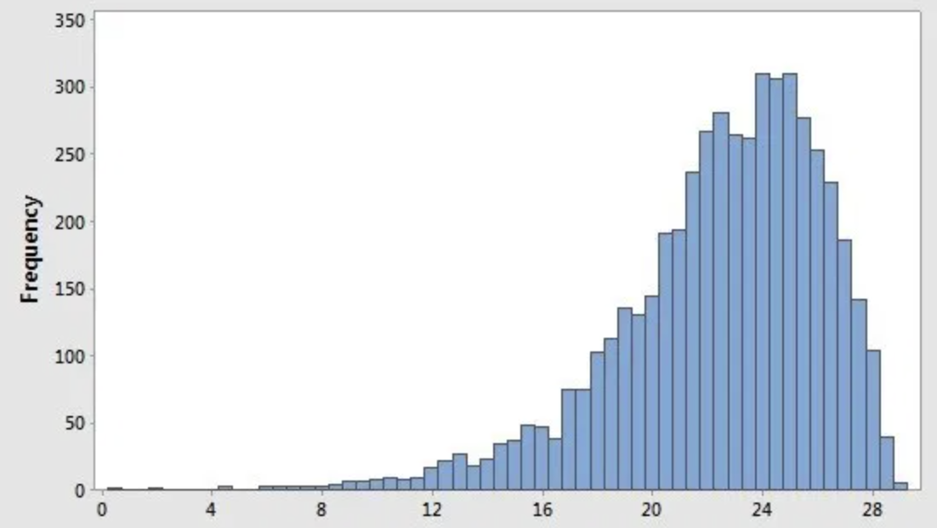
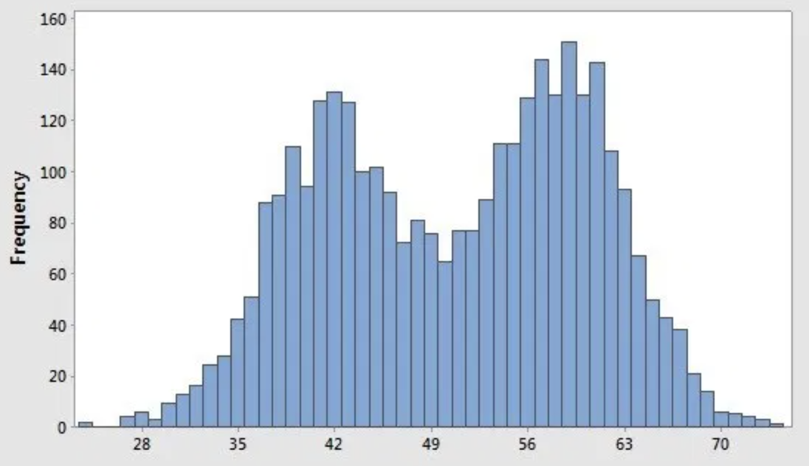
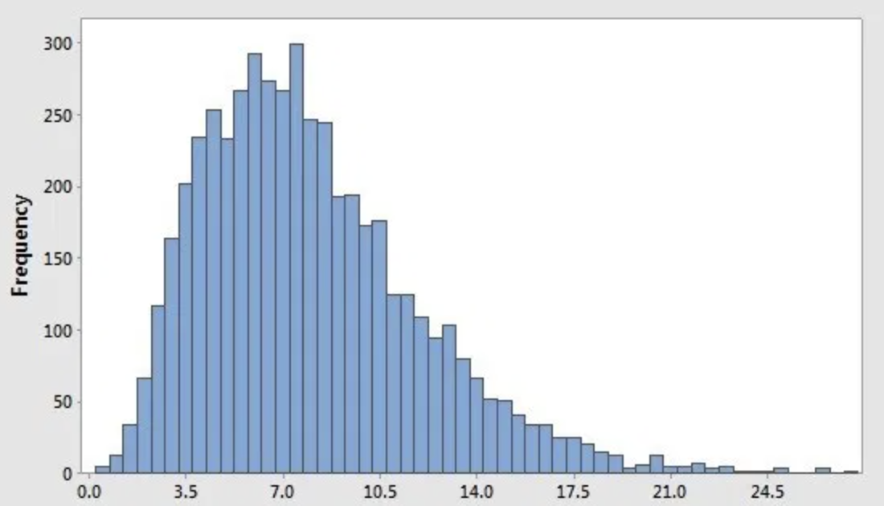
Some Shapes of Histogram
Bell Shape / Symmetric
Left Skewed
Have a clear center with the approximately symmtric left and right area
Concentrate on right side and with a long trail on the left side
Bimodal
Right Skewed
Two peaks, usually two different groups
Concentrate on left side and with a long trail on the right side

Slide 10
The Average and the Standard Deviation
Average and Median with Histogram
Standard Deviation with Histogram
Exercise
CHAPTER 4

Slide 11
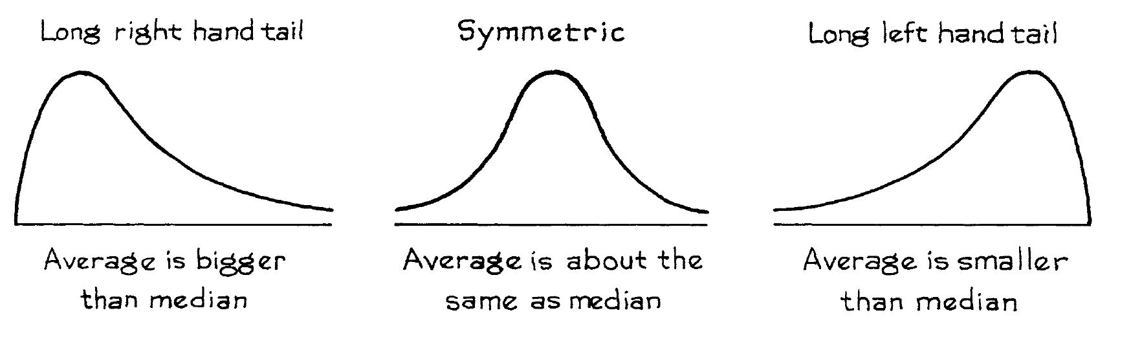
Average and Median with Histogram
Average: The sum of the list of numbers divided by how many there are.
Median: The middle number in a sorted list of numbers, ascending or descending.
Median
Average
Average
Median

Slide 12
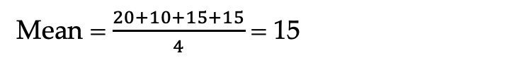
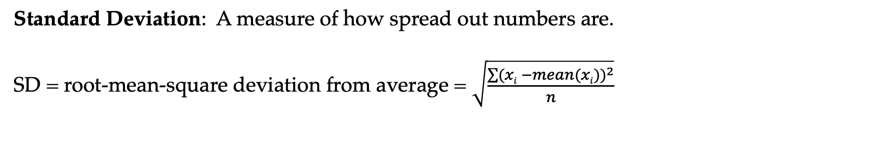
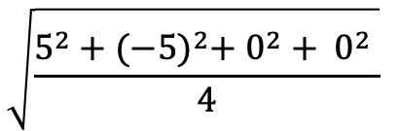
Standard Deviation with Histogram
Standard Deviation: A measure of how spread out numbers are.
SD = root-mean-square deviation from average = $\sqrt{\frac{\sum{{(xi −mean(xi))}^{2}}}{n}}$
Example: Find the SD of the list 20, 10, 15, 15.
Step1: find the average (mean)
Mean = $\frac{20+10+15+15}{4}$ = 15
Step2: find the deviations from average
5, -5, 0, 0
Step3: calculate the r.m.s size of the deviations
$$\sqrt{\frac{5^{2}+{(−5)}^{2}+ 0^{2}+ 0^{2} }{4}}$$

Slide 13
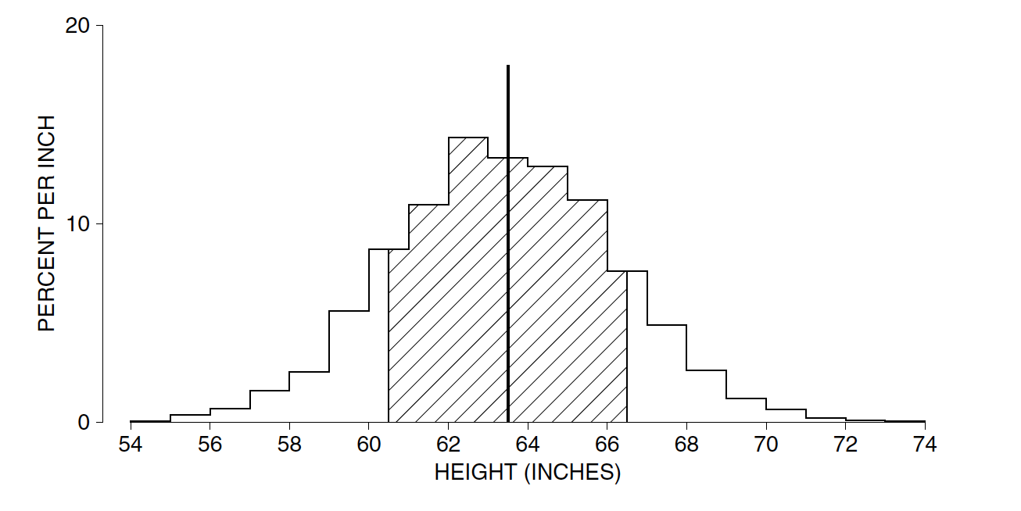
Histogram of Heights of Women Age 18
Average
The shaded area represents the total percentage of women (72%) differed from average by one SD (3 inches) or less
1 SD = 3
NOTE:
Most number on the list will be somewhere around one SD away from the average.
Very few will be more than two or three SDs away.

Slide 14
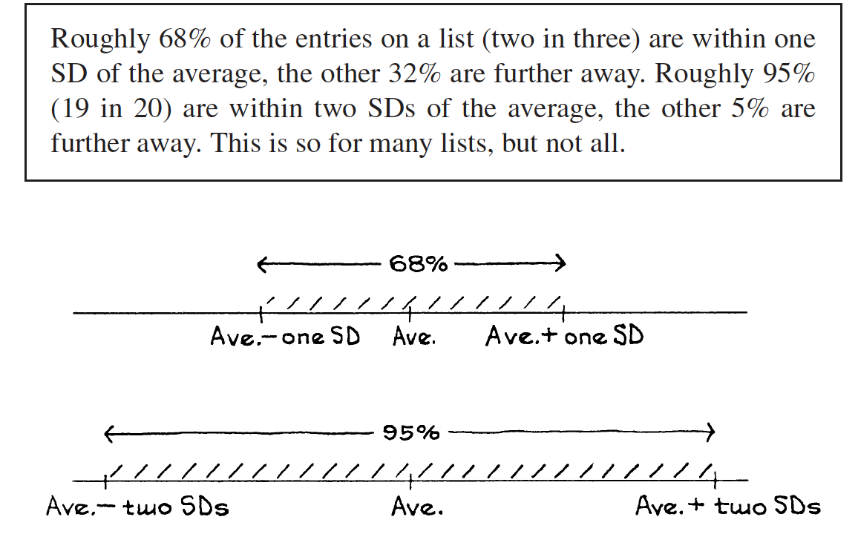
The area under the normal curve between −3 and +3 is about 99.7%.

Slide 15
The Normal Approximation for Data
The Normal Curve
Z Score
Percentiles
Exercise
CHAPTER 5

Slide 16
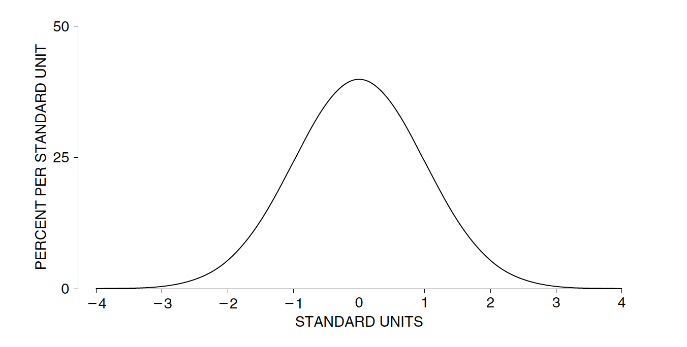
The Normal Curve
For standard normal distribution
Bell shape / Symmetric around 0
Mean = 0
Standard Deviation = 1
Variance = 1

Slide 17
Z Score
Z score = (Number – Mean) / SD
Z score tells how many SDs a value is above (+) or below (-) the average
Normal approximation: Convert all number into Z score
Easy to compare with different groups of data (different normal distributions)
(Number = Z score * SD + Mean)
With Z score and the Normal table,
we could calculate the numbers in some SDs and percentiles.

Slide 18
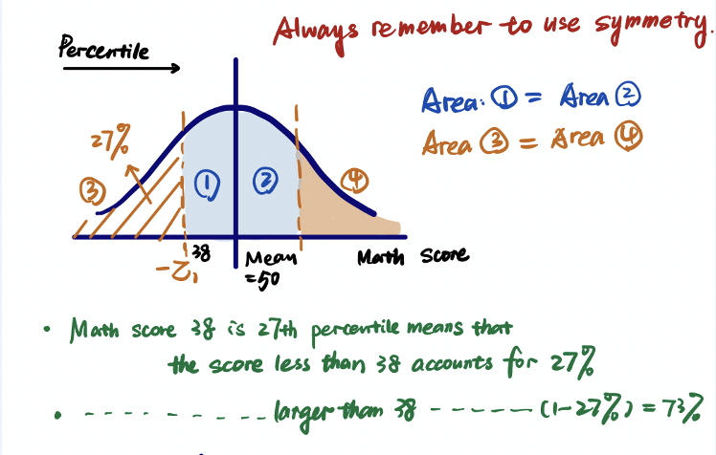
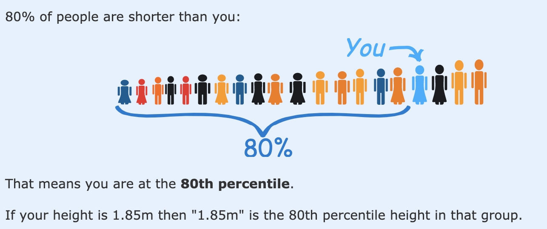
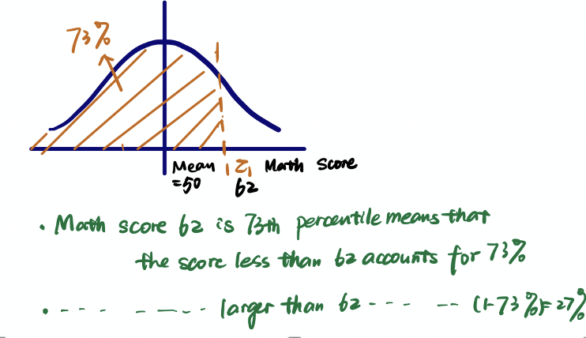
Percentile
A number related to rank
With the information of percentiles, we could use the Normal table to get Z scores, and thus get the values of the data set.

Slide 19
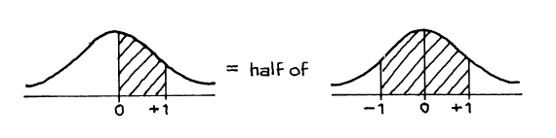
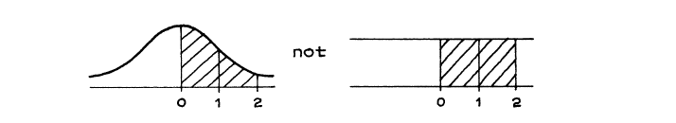
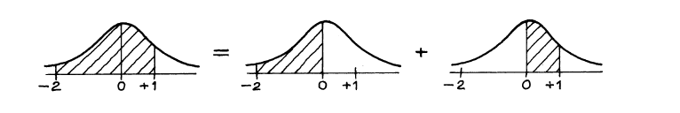
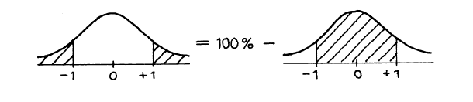
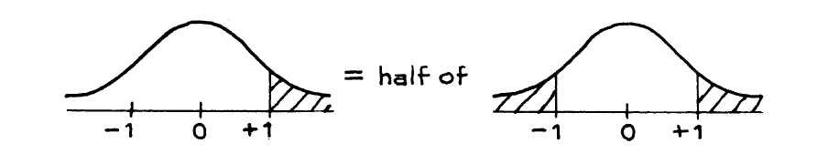
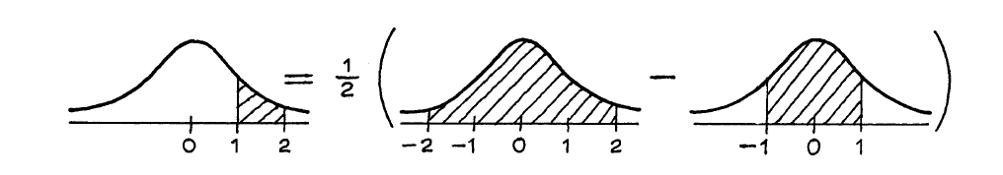

Slide 20
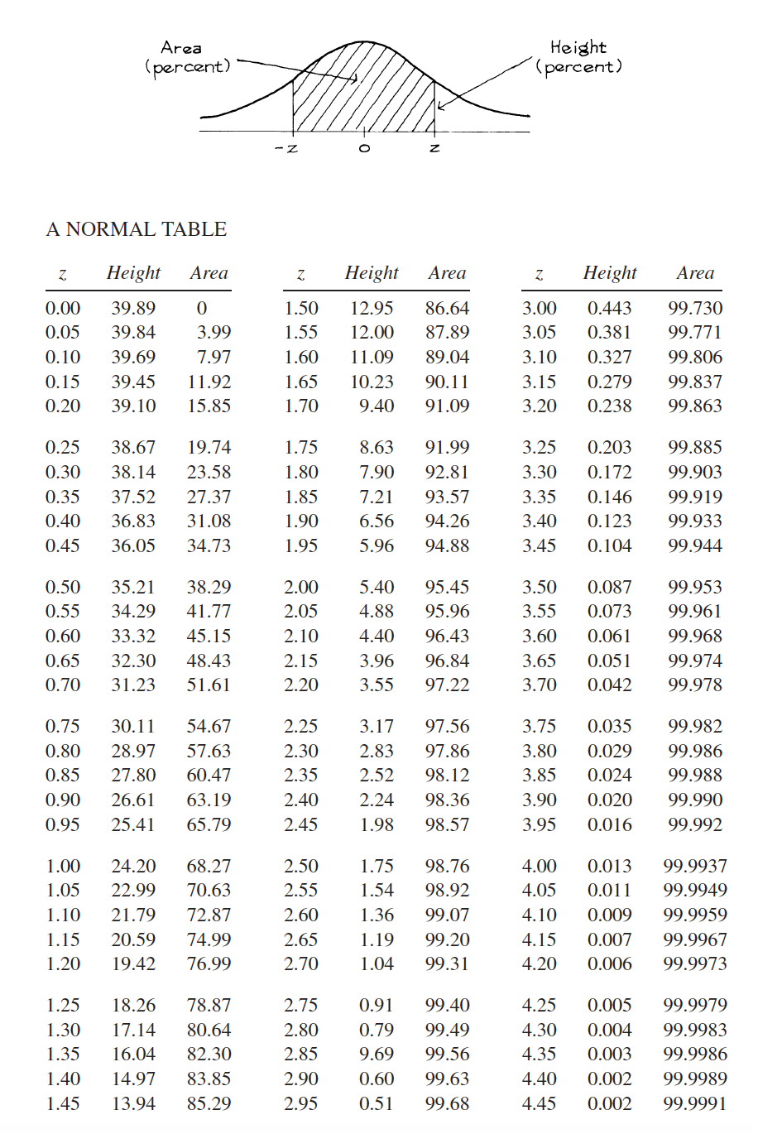
Gives us the statistics of the normal curve.
Area: percentage of the shadow part
Z: Z score
Mainly two kinds of questions using the Normal table:
Number -> Z score -> Normal table -> Percentile
Percentile -> Normal table -> Z score -> Number

